Slide 1
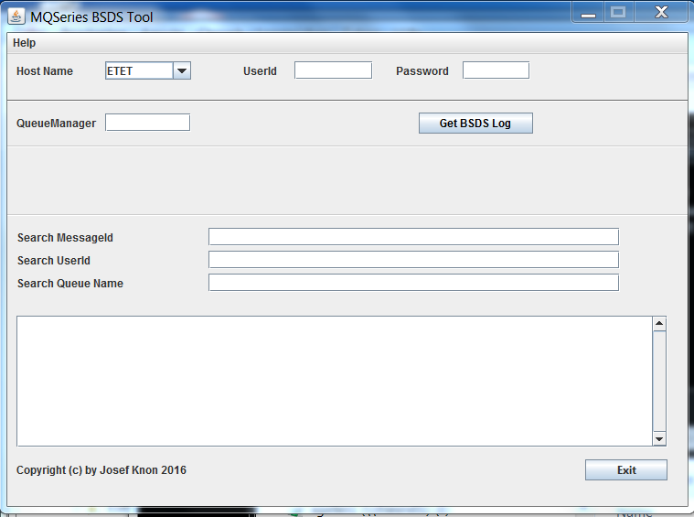
MQ BSDS Log-Analyse Tool

Slide 2
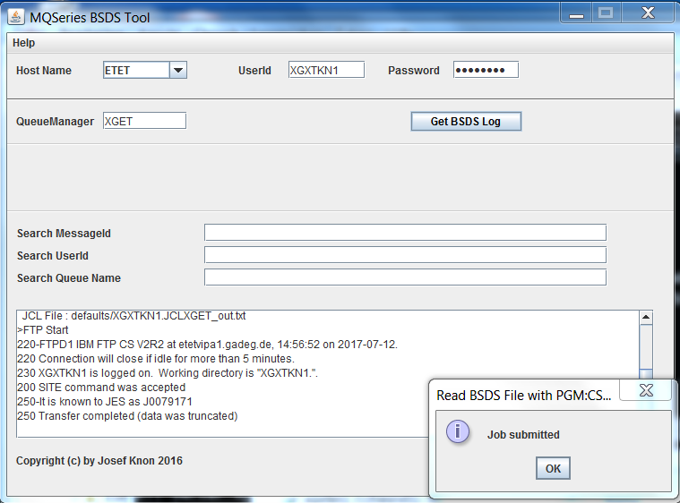
MQ BSDS Log-Analyse Tool

Slide 3
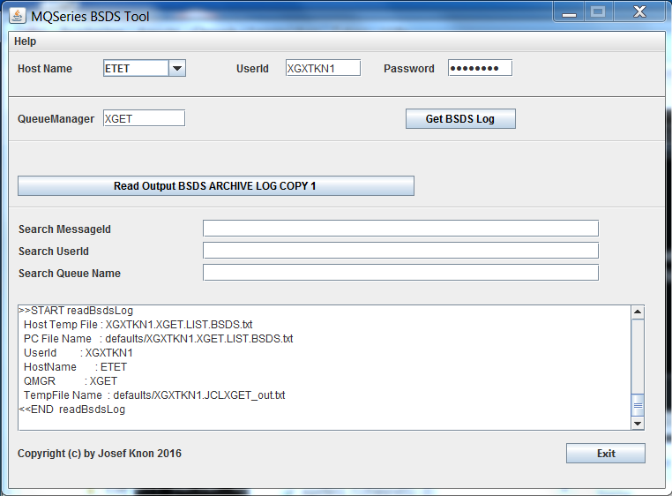
MQ BSDS Log-Analyse Tool

Slide 4
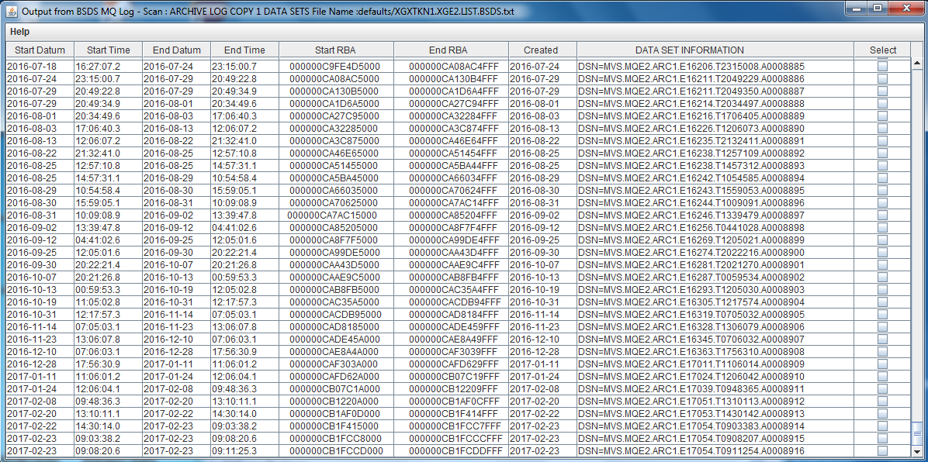
MQ BSDS Log-Analyse Tool

Slide 5
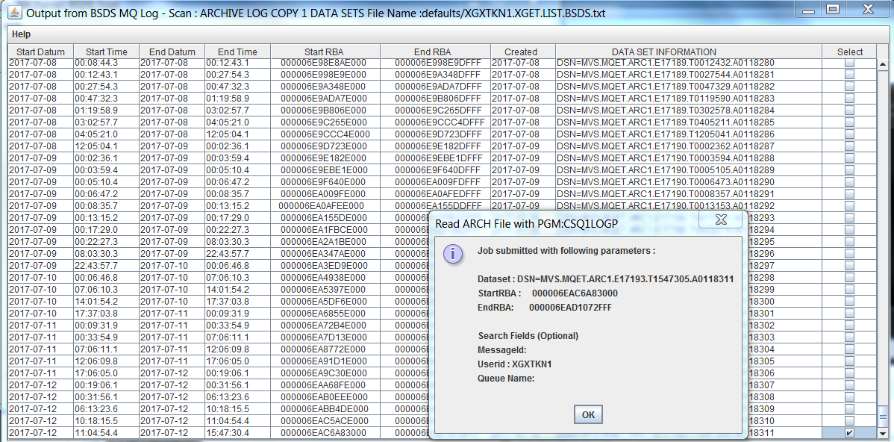
MQ BSDS Log-Analyse Tool

Slide 6
MQ BSDS Log-Analyse Tool

Slide 7
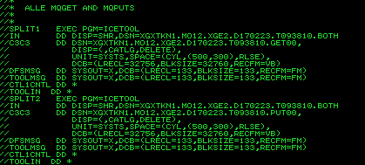
MQ BSDS Log-Analyse Tool

Slide 8
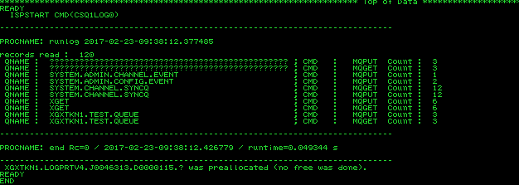
MQ BSDS Log-Analyse Tool

Slide 9
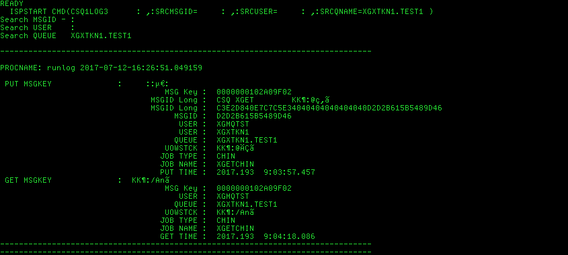
MQ BSDS Log-Analyse Tool

